Slide 1
Traffic Management System
Introduction
One of the major problems faced in any metro city is traffic congestion.
Heavy traffic is a headache for each and every person driving the vechicles
and even to the traffic police in controlling the traffic.
Traffic congections has a negative impact on economy, the environment and the overall quality of life.
There are two ways through which traffic is been controlled
1)Manually
2)Systematically(controllers).
However the whole idea of a fixed time traffic light controller is not convenient for cities where traffic flow is variable.
For this reason a dynamic traffic control system is need, which controls the traffic signals according to the density of traffic.
In our project we focus on optimization of traffic light using IR sensor & Arduino UNO as a microcontroller.
In our project our approach is to take data/input from IR sensor it will allows us to detect whether the road is congested or not & will allows us to manage our traffic according to our input.

Slide 2
Realtime
Real-time systems in case of trafﬁc managing system take the input of the currentsituation through video surveillance or WSNs and deal with the situation. The trafﬁcsignals are controlled according to the presence of vehicles and are operated536 S.P. Biswas et al.automatically in real time. A real-time optimization model was used by Dotolieet al.
[1] that investigated the issue of trafﬁc control in urban areas. The model tookinto considerations the trafﬁc scenarios which also include pedestrians. This tech-nique was applied for analyzing real case studies. Wenjie et al.
[2] concentrate oncalculating the time that a vehicle requires to reach the intersection from a particularpoint, dynamically, by the use of sensors. By this, data performs various calcula-tions to ﬁnd the green light length. Albers et al.
[3] used real-time data to monitorcurrent trafﬁcﬂows in a junction so that the trafﬁc could be controlled in a con-venient way. Reliable short-term forecasting video captured in a recorder plays animportant role in monitoring the trafﬁc management system. The data required canbe easily provided by the CCTV cameras that can be beside the roads as perrequirement.

Slide 3
Data Analysis Systems
Data analytical systems are those systems that take the present or statistical data,process them in the processor, and then act according to predeﬁned algorithm. Likereal-time systems, it may collect data in real time, but is unable to take any decisionin real time, i.e., it must follow the instructions that are provided to it. Yousef et al.[16] suggested a scheme of solving trafﬁc congestion in terms of the average waitingtime and length of the queue at the isolated intersection and provide efﬁcient ﬂow inglobal trafﬁc control on multiple intersections with the accordance of real-time data.Thus, the data collected can be used in various ways depending on the perspective ofthe user.

Slide 4
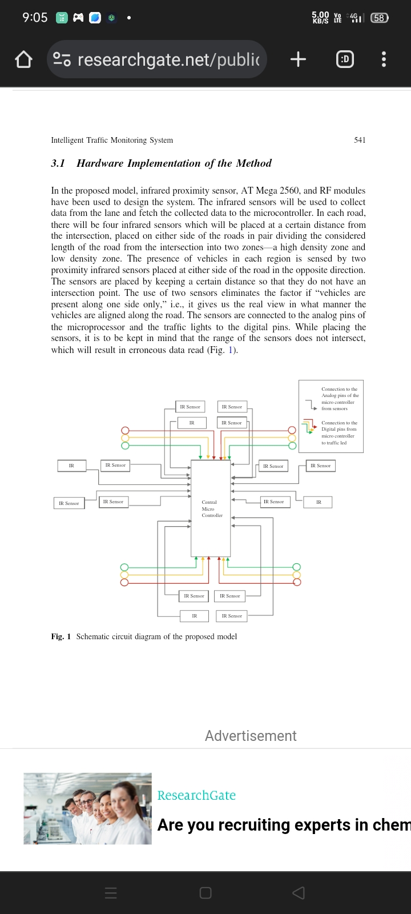
Hardware Implementation of the Method

Slide 5
FUTURE WORK
Even though the proposed system improves the current traffic monitoring system, there is room for the following improvements that can be added in the near future:
1) Accident Monitoring: Everyone is aware about the frequency of accidents that happen on the road. Whenever such an unforeseen event takes place, it takes a long time to provide assistance to the victim and this leads to many fatalities which could have been somehow prevented. With the help of traffic cameras installed at the junctions, any vehicle that happens to remain stationary in an inapt position (to avoid confusion with parked cars) could be identified as an effected automobile and the emergency services could be notified immediately. This would not only help them to respond faster in these kind of situations but also help in avoiding the resulting traffic jams.
2) Adaptive System for Emergency Vehicles: It is estimated that 1 in 10 patients in India loses his/ her life due to the ambulance being stuck in traffic [10]. This is a huge number and makes us realize how bad the existing traffic management is. To overcome this situation, a model can be trained which will allow the cameras to identify any emergency vehicle and allow it to cross a traffic junction at the earliest.
3) Recognizing Traffic Rule Violators: Traffic rule violators are a common sight on most traffic junctions. People tend break traffic laws and expect to get away with it without facing any consequences. Not long back, these offenders would be fined by identifying their number plate and sending them an online penalty.

Slide 6
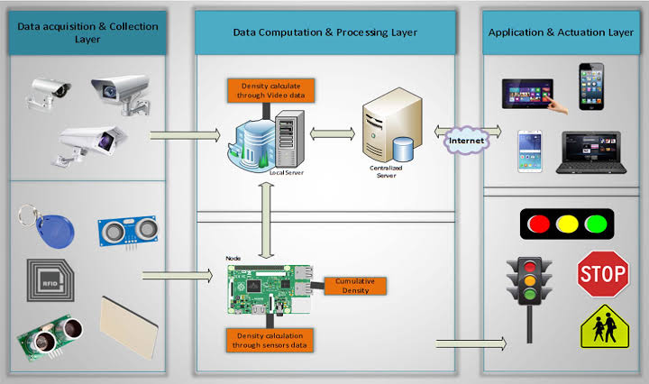
Realtime-monitoring

Slide 7
Real-time traffic monitoring typically involves a combination of technologies, including HTML for the user interface. Here's a high-level example of how you could create a basic real-time traffic monitoring system using HTML, JavaScript, and potentially other technologies (such as a backend server and a database):
1. **HTML for Frontend:**
Create an HTML page that will display the real-time traffic data. You can use HTML to structure the layout of your page and provide a canvas or container for displaying the data.
2. **JavaScript for Real-time Updates:**
Use JavaScript to fetch real-time traffic data from various sources. This data can come from APIs provided by traffic monitoring agencies or sensor networks. Use AJAX requests or modern Fetch API to retrieve this data at regular intervals.

Slide 8
Program
```html
<script>
function updateTrafficData() {
// Use AJAX or Fetch to get real-time traffic data.
fetch('your_traffic_data_api_endpoint')
.then(response => response.json())
.then(data => {
// Update the HTML elements with the real-time data.
document.getElementById('traffic-speed').textContent = data.speed;
document.getElementById('traffic-congestion').textContent = data.congestion;
// Add more elements as needed.
});
}
// Update data every x seconds.
setInterval(updateTrafficData, 10000); // Update every 10 seconds.
</script>
```

Slide 9
3. **Visualize Data:**
Use HTML and CSS to create visual representations of the real-time traffic data. For example, you can display traffic speed, congestion levels, and incidents on a map or in charts. You might also use libraries like Google Maps API for mapping.
4. **Backend Server (Optional):**
If you need to preprocess or store data, you might need a backend server (e.g., using Node.js, Python, or Ruby). The server can fetch and process data from various sources and provide it to the frontend.
5. **Database (Optional):**
If you want to store historical traffic data, you can use a database like MySQL, PostgreSQL, or NoSQL databases. This data can be used for trend analysis and historical comparisons.
6. **Real-time Data Sources:**
Integrate with real-time data sources, such as traffic cameras, GPS data, or official traffic APIs provided by local transportation authorities.
7. **User Interaction:**
You can provide user interaction features, such as filtering by location, traffic incidents, or traffic camera views.

Slide 10
Functioning of Traffic Monitoring System Using IoT Capabilities
This intelligent system comprises several components, including wireless sensors, RFID tags, and BLE beacons installed at the traffic signals to monitor the movement of vehicles. A real-time data analytics tool connects the Geographic Information System (GIS-enabled) digital roadmap with control rooms for real-time traffic monitoring.
The smart traffic management system captures the images of vehicles at the signals using the digital image processing technique. This data is then transferred to the control room via wireless sensors. The system also leverages BLE beacons or RFID tags to track the movement of vehicles and keep traffic congestion in control, track down stolen vehicles and even clear the road for emergency vehicles that are installed with RFID readers.

Slide 11
Advantages of a Smart Traffic Management System
Cleaner, greener, safer, and more accessible roads are a few benefits of implementing IoT and intelligent technology.
It helps with the following:
Reducing traffic jams and accidents on the streets
Ensuring immediate clearance for emergency vehicles
Facilitating safer and shorter commute times
Reducing congestion & energy consumption at intersections
Offering significant productivity benefits with real-time monitoring of crucial infrastructures
Reducing operating costs with efficient traffic management processes
Ensuring compliance with the regulations for reducing the carbon footprint
Saving billions of gallons of fuel wasted every year
Accurate tracking & quick recovery of lost and stolen vehicles

Slide 12
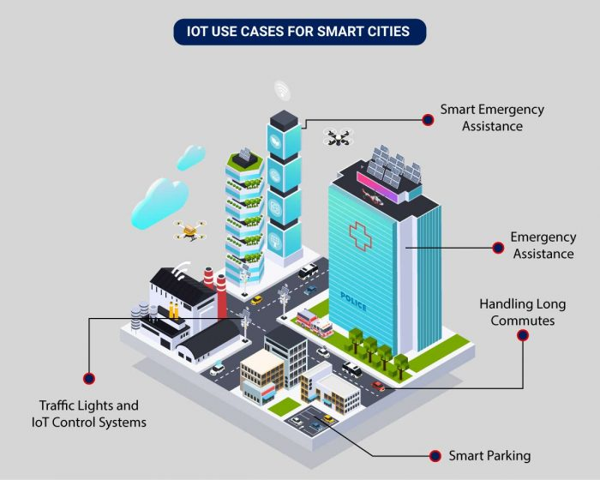
Application of IoT in Traffic Management
City governments can improve their operations & infrastructure by placing IoT sensors and tracking devices on roads and highways for recording, analyzing, and sharing data in real-time.
Uses of IoT in Traffic Management
An intelligent traffic monitoring system using IoT capabilities has so many factors & use cases, including;
Traffic Lights and IoT Control Systems
Parking Enabled through IoT:
Emergency Assistance through IoT
Commute Assistance

